Slide 1
Cooking Tools & Equipment

Slide 2
Ladle
Dipper for liquids that need to be served.

Slide 3
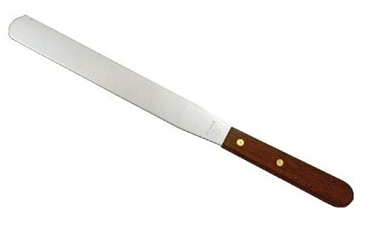
Straight Edge Spatula
Used for leveling off; spreading frosting

Slide 4
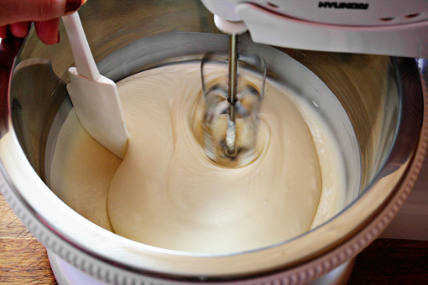
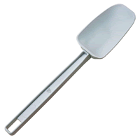
Rubber Scraper
Scrapes a bowl clean BUT could melt if used in a saucepan.

Slide 5
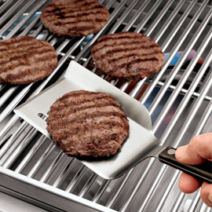
Turner
Utensil for lifting and turning items like pancakes and meat.
Should NOT be used in a nonstick pan if it is made of metal.

Slide 6
Wire Whisk
Used to add air to light mixtures
Metal whisk should NOT be used in a nonstick pan. Instead used a plastic or rubber whisk.

Slide 7
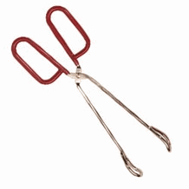
Tongs
Used to safely grab and turn food items

Slide 8
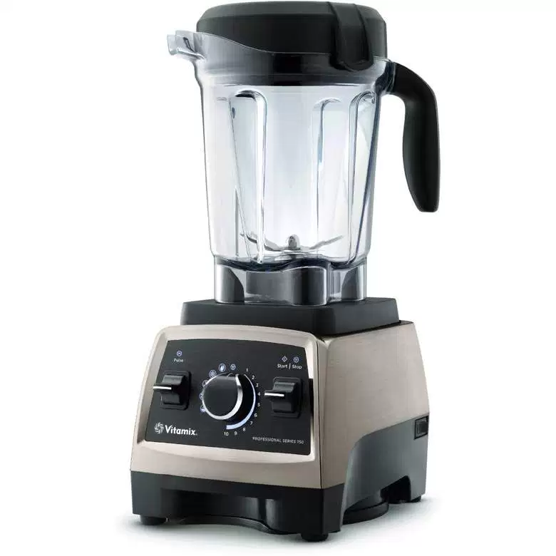
Blender
Mixes things to liquefy, chop, or puree

Slide 9
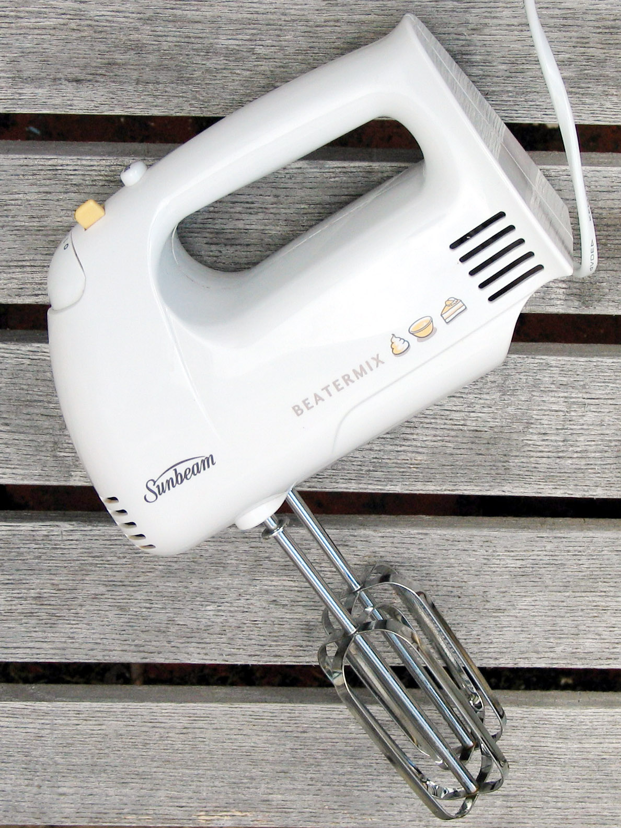
Hand Mixer
Rotates beaters to stir, whisk, or beat ingredients
Electric powered

Slide 10
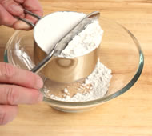
Dry Measuring Cups
Used to measure DRY ingredients only
Remember the standard set: 1/4 cup, 1/3 cup, 1/2 cup, 1 cup.

Slide 11
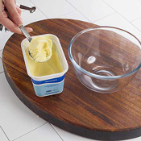
Measuring Spoons
Used to measure SMALL amounts of ingredients
Can be used for wet OR dry ingredients
Remember the standard set: ¼ teaspoon, ½ teaspoon, 1 teaspoon, 1 tablespoon

Slide 12
Liquid Measuring Cup
Used to measure LIQUIDS ingredients only
Bend down to check it at eye level
Come in various sizes: 1 cup, 2 cups, 4 cups and 8 cups or more!

Slide 13
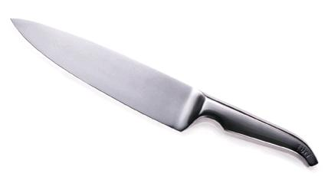
Chef’s Knife or French Knife
Large knife for chopping and cutting large items like meat and vegetables.

Slide 14
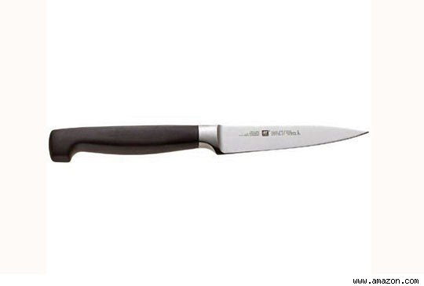
Paring Knife
Small knife for peeling fruits & vegetables or making other small cuts such as garnishes.

Slide 15
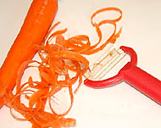
Vegetable Peeler
Thin blade to remove the outer surface of fruit and vegetables.

Slide 16
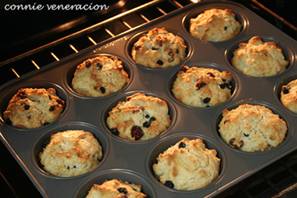
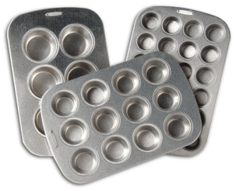
Muffin Pans
A rectangular pan with round depressions for baking muffins and cupcakes.

Slide 17
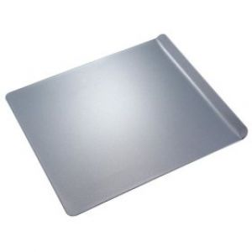
Cookie Sheet
A flat baking sheet for baking cookies with one raised edge

Slide 18
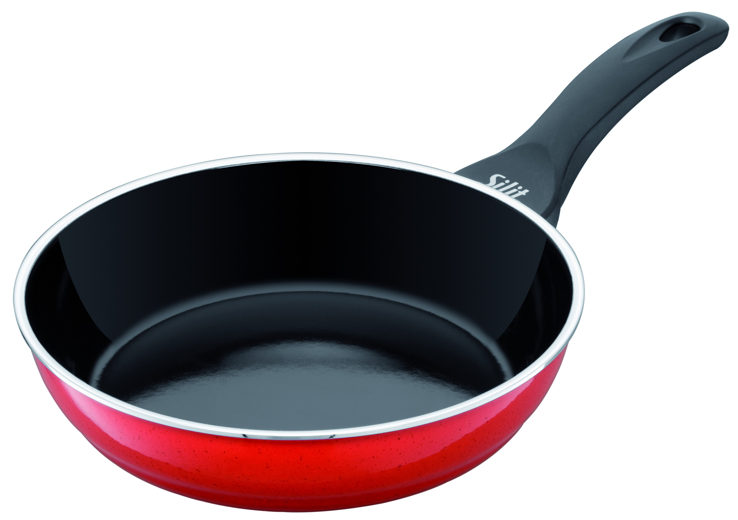
Frying Pan
A shallow pan with a long handle, used for cooking food in hot fat or oil.

Slide 19
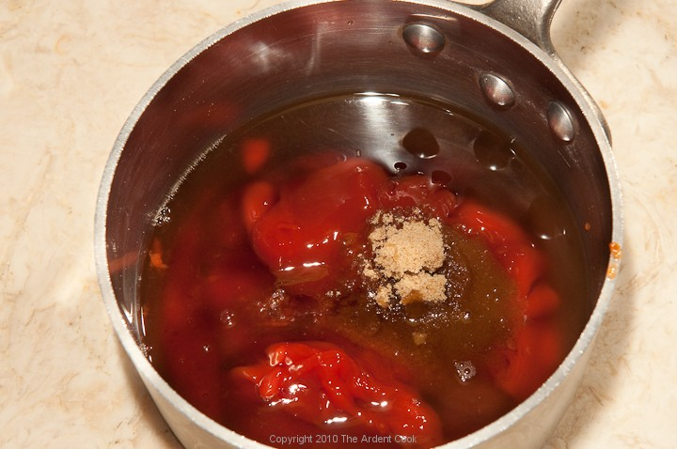
Saucepan
A deep pan with a handle and lid for boiling, simmering and steaming foods.

Slide 20
Colander
A bowl with holes used to drain pasta and other liquids from food.

Slide 21
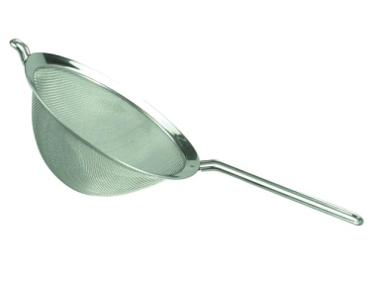
Strainer
A fine wire mesh used to drain liquids from smaller amounts of food.

